Slide 1
Protocol Architectures
Introduction to OSI and TCP/IP Protocol Architectures

Slide 2
Networking Standards
Standards
Standards are guidelines vendors or manufacturers voluntarily adhere to in order to make their products compatible with products from other manufacturers/vendors
Standards address:- Size, Shape, Material, Function, Speed, Distance, etc, of the manufactured products.
Where do they come from?
  Standard setting bodies
  Governments
Two types
  Market-driven and voluntary
  Government-regulated and mandatory

Slide 3
Networking Standards Organizations
American National Standards Institute (ANSI)
  Comprised of industry and government representatives
  Determine standards for electronics industry in addition to other fields
  Standards developed by ANSI include standards for codes, alphabets, signaling schemes in computers
Industry Associations
  Telecommunication Industry Association (TIA) is responsible for developing communications standards
  Electronic Industries Alliance (EIA) international industry association that is best known for publishing electrical wiring and transmission standards.
  Standards produced by the EIA or TIA are often labeled with the combined prefixes “EIA/TIA” or “TIA/EIA” e.g. EIA/TIA 568 A

Slide 4
Networking Standards Organizations
Institute of Electrical and Electronic Engineers (IEEE)
  International society of engineering professionals
  Promotes development and education in electrical engineering and computer science fields
International Organization for Standardization (ISO)
  Collection of standards organizations
  Goal is to establish international technological standards to facilitate global exchange of information and barrier-free trade
  ISO is best known for its OSI Reference Model.

Slide 5
Networking Standards Organizations
International Telecommunication Union (ITU)
  Formerly called Consultative Committee on International Telegraph and Telephony (CCITT)
  United Nations agency that regulates international telecommunications
  Assists developing countries
Internet Engineering Task Force (IETF)
  Part of the Internet Architecture Board (IAB)
  IETF proposes and publishes Internet RFCs
  IAB determines which RFCs become standards, based on IETF recommendations

Slide 6
Advantages and Disadvantages
Advantages
  Assures a large market, which encourages mass production and often lowers costs
  Encourages vendors to enter the market because investment is protected
  Allows products from multiple vendors to communicate, providing consumers with wider selection
Disadvantages
  Standards process can freeze technology too early, due to the length of the standards-setting process and the speed with which technology changes
  Current process allows for multiple standards for the same thing

Slide 7
The OSI Model
Open Systems Interconnection (OSI) Model
  Model for understanding and developing computer-to-computer communication
  Developed in the 1980s by ISO
  Divides network architecture into seven layers
Network architect
  Professional involved in network design

Slide 8
A Layered Network Model
The process of breaking up the functions or tasks of networking into layers reduces complexity.
Each layer provides a service to the layer above it in the protocol specification.
Each layer communicates with the same layer’s software or hardware on other computers.
The lower 4 layers (transport, network, data link and physical —Layers 4, 3, 2, and 1) are concerned with the flow of data from end to end through the network.
The upper four layers of the OSI model (application, presentation and session—Layers 7, 6 and 5) are orientated more toward services to the applications.
Data is encapsulated with the necessary protocol information as it moves down the layers before network transit.

Slide 9
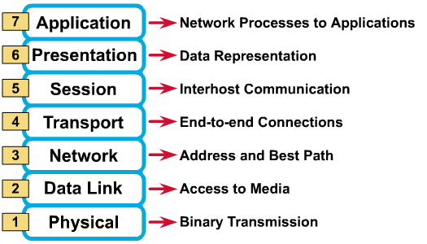
The OSI Model

Slide 10
Physical layer
The physical layer deals with the physical characteristics of the transmission medium.
It defines the electrical, mechanical, procedural, and functional specifications for activating, maintaining, and deactivating the physical link between end systems.
Such characteristics as voltage levels, timing of voltage changes, physical data rates, maximum transmission distances, physical connectors, and other similar attributes are defined by physical layer specifications.
Examples : EIA/TIA-232, RJ45, NRZ.

Slide 11
Data Link layer
Providing access to the networking media and physical transmission across the media to enable the data to locate its intended destination.
Reliable transit of data across a physical link by using the Media Access Control (MAC) addresses.
Use the MAC address to define a hardware or data link address in order for multiple stations to share the same medium and still uniquely identify each other.
Concerned with network topology, network access, error notification, ordered delivery of frames, and flow control.
Examples :- Ethernet, Frame Relay, FDDI.

Slide 12
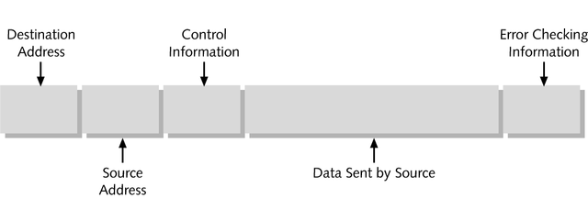
Frames
Structured package for moving data
Includes raw data (or payload) along with sender’s and receiver’s:
  Network addresses
  Error-checking and control information
A simplified data frame

Slide 13
Network Layer
Defines end-to-end delivery of packets.
Defines logical addressing so that any endpoint can be identified.
Defines how routing works and how routes are learned so that the packets can be delivered.
The network layer also defines how to fragment a packet into smaller packets to accommodate different media.
Routers operate at Layer 3.
Examples :- IP, IPX, AppleTalk.

Slide 14
Transport Layer
Error Control: Ensures that data are transferred between points reliably and without errors
Segmentation: Splits data from the sending host's system and reassembles the data into a data stream on the receiving host's system.
Flow control: Method of gauging appropriate rate of data transmission
Sequencing: Process of assigning a placeholder to each piece of a data block to allowing receiving node’s Transport layer to reassemble data in correct order
Protocols include TCP (Transmission Control Protocol) and UDP (User Datagram Protocol).

Slide 15
Session Layer
Defines how to start, control and end conversations (called sessions) between applications.
  Includes the control and management of multiple bi-directional messages using dialogue control.
It also synchronizes dialogue between two hosts' presentation layers and manages their data exchange.
Offers provisions for efficient data transfer.
Examples :- SQL, ASP(AppleTalk Session Protocol).

Slide 16
Presentation Layer
Ensures that the information that what the application layer of one system sends out is readable by the application layer of another system.
If necessary, the presentation layer translates between multiple data formats by using a common format.
Provides encryption and compression of data.
Examples :- JPEG, MPEG, ASCII, EBCDIC, HTML.

Slide 17
Application Layer
The OSI layer that is closest to the user.
It provides network services to the user’s applications.
It differs from the other layers in that it does not provide services to any other OSI layer, but rather, only to applications outside the OSI model.
Examples of such applications are spreadsheet programs, word processing programs, and bank terminal programs.
The application layer establishes the availability of intended communication partners, synchronizes and establishes agreement on procedures for error recovery and control of data integrity.

Slide 18
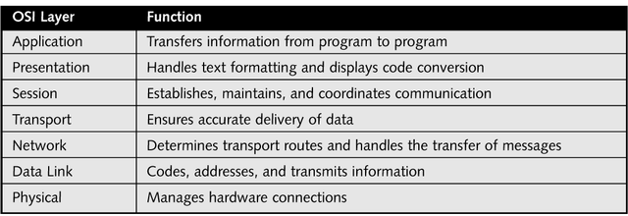
Applying the OSI Model
Functions of the OSI layer

Slide 19
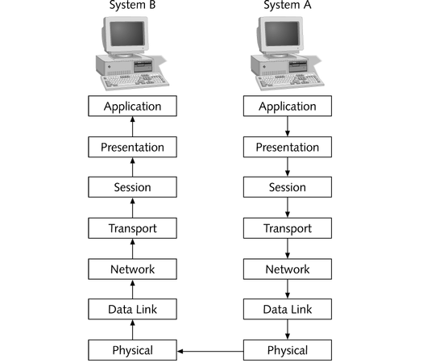
Communication Between Two Systems
Data transfer between two systems

Slide 20
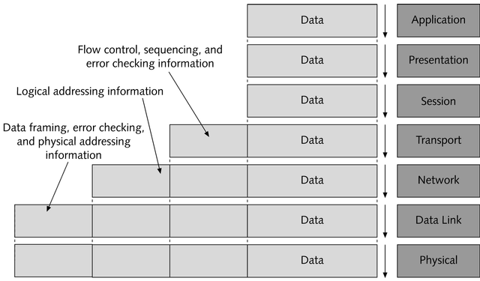
Communication Between Two Systems
Segment
Packet
Frame
Bits
Data transformed through the OSI Model

Slide 21
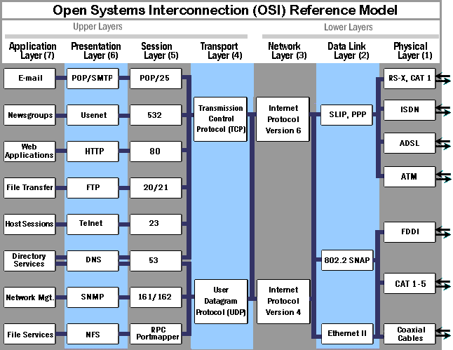
OSI Reference Model

Slide 22
(TCP/IP) PROTOCOL SUITE
This model was initially developed & used by ARPANET (Advanced Research Project Agency Network). ARPANET was a community of researchers sponsored by the U.S. department of defense.
It connected many universities and government installations using leased telephone lines. ARPAnet is the best- known TCP/IP network.
TCP and IP are two of the protocols in this suite.
TCP/IP is modeled in layers and leads to the term protocol stack, which refers to the stack of layers in the protocol suite.

Slide 23
(TCP/IP) PROTOCOL SUITE
By dividing the communication software into layers, the protocol stack allows for division of labor, ease of implementation and code testing, and the ability to develop alternative layer implementations.
Layers communicate with those above and below via concise interfaces.
In this regard, a layer provides a service for the layer directly above it and makes use of services provided by the layer directly below it.
For example, the IP layer provides the ability to transfer data from one host to another without any guarantee to reliable delivery or duplicate suppression.

Slide 24
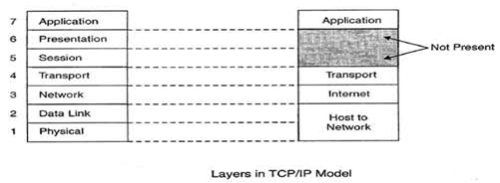
(TCP/IP) PROTOCOL SUITE

Slide 25
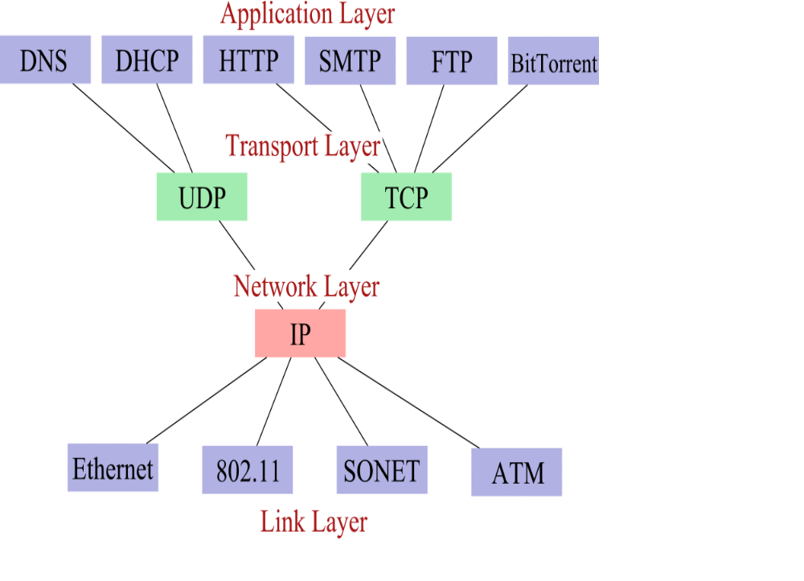
(TCP/IP) PROTOCOL SUITE

Slide 26
Application Layer
The application layer is provided by the program that uses TCP/IP for communication.
An application is a user process cooperating with another process usually on a different host.
Application Protocols in TCP/IP model
Hypertext Transfer Protocol (HTTP)- supports text based applications
Simple Mail Transfer Protocol (SMTP)- the protocol that provides services for sending and receiving email across the Internet.
File Transfer Protocol (FTP)- used to copy files between computers over a TCP/IP network.
Telnet- supports remote log-in to a host from another host on the network.

Slide 27
Transport Layer
The transport layer provides the end-to-end data transfer by delivering data from an application to its remote peer.
Transport layer consists of TCP and UDP
Transmission Control Protocol (TCP), provides connection-oriented reliable data delivery, duplicate data suppression, congestion control, and flow control.
User Datagram Protocol (UDP) provides connectionless, unreliable, best-effort service.
Applications using UDP as the transport protocol have to provide their own end-to-end integrity, flow control, and congestion control, if desired.
UDP supports higher level protocols that provide error checking and flow control operations or have no need for these services (e.g., DNS).

Slide 28
Inter-network Layer
The internet layer of TCP/IP directly corresponds to the OSI model's network layer.
This layer provides routing and network addressing functions.
The Internet Protocol (IP), the Internet Control Message Protocol (ICMP), and the Internet Group Message Protocol (IGMP), ARP, and RARP reside in the internet layer.

Slide 29
Inter-network Layer
ICMP reports problems and errors with network devices across the network.
IGMP provides the mechanism to send one message to a group of hosts on a network. This process is referred to as multicasting.
The Address Resolution Protocol (ARP) is used by a sending host when it knows the IP address of the destination but needs the Ethernet address.
ARP is a broadcast protocol - every host on the network receives the request. Each host checks the request against its IP address - the right one responds.
RARP does the opposite of ARP and is used when booting diskless workstations.

Slide 30
Network Interface Layer
The network interface layer, also called the link layer or the data-link layer or Host to Network Layer, is the interface to the actual network hardware.
This interface may or may not provide reliable delivery, and may be packet or stream oriented.
TCP/IP does not specify any protocol here, but can use almost any network interface available, which illustrates the flexibility of the IP layer.
Examples are IEEE 802.2, X.25, ATM, FDDI, and even SNA.
TCP/IP specifications only standardize ways of accessing those protocols from the internet work layer.

Slide 31
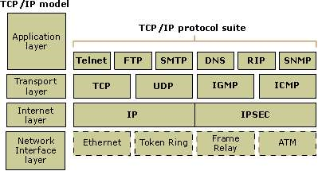
(TCP/IP) PROTOCOL SUITE

